Slide 1
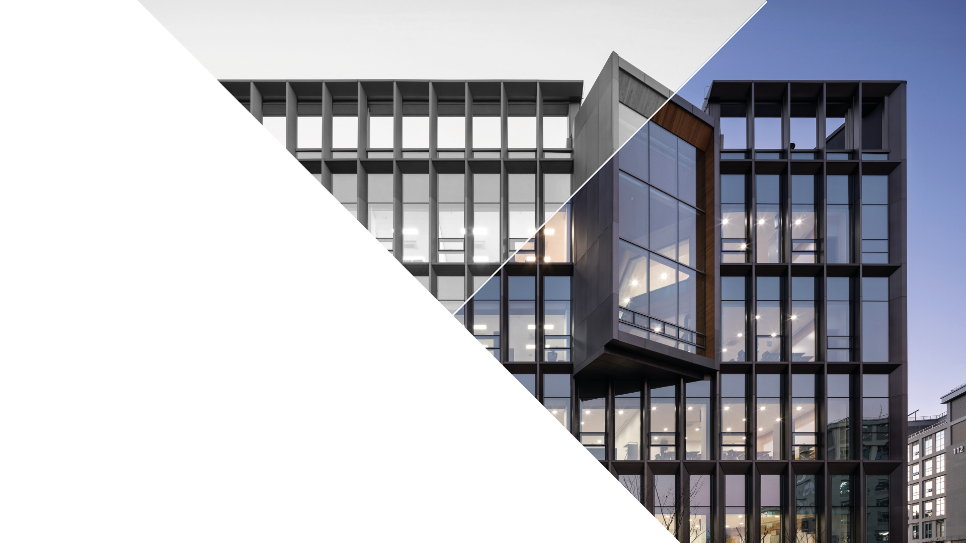

Privacy-Preserving
Machine Learning
실습
2022.08.03
CONTACT
Artificial Intelligence Graduate School
5th Engineering Building Room 3rd floor

Slide 2
목차
1. 파일 업로드
2. 공유하기
3. 다운로드
4. 실행하기

Slide 3
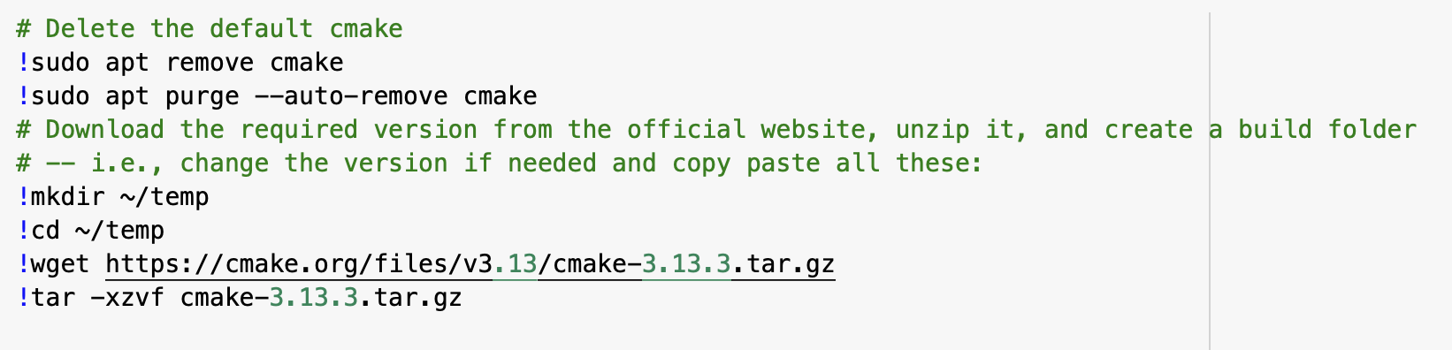
1. SEAL library 설치
cmake 업그레이드
Notes:
20 sec

Slide 4
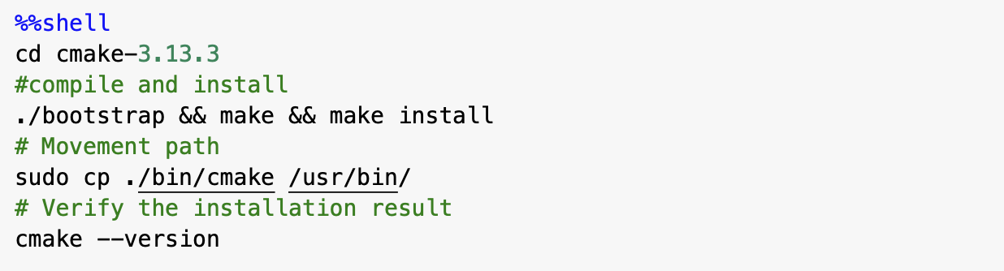
1. SEAL library 설치 (continued’)
cmake 업그레이드
Notes:
11min 39sec

Slide 5
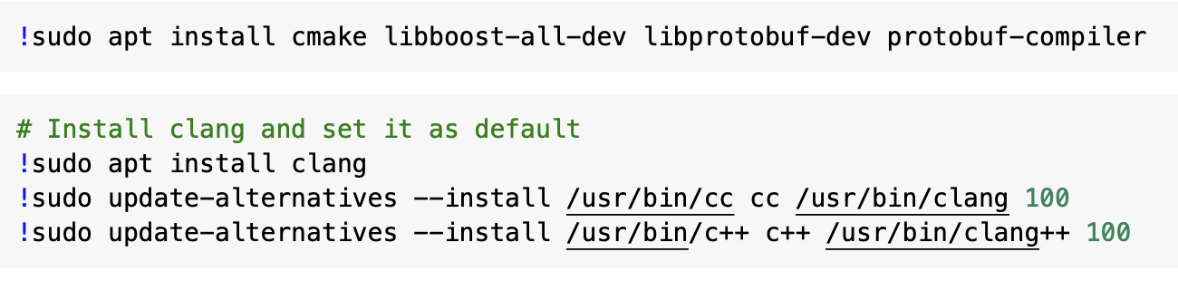
1. SEAL library 설치 (continued’)
dependencies 설치
Notes:
5sec + 2sec

Slide 6
1. SEAL library 설치 (continued’)
SEAL library 다운로드
SEAL library 설치
Notes:
2 min

Slide 7
1. SEAL library 설치 (continued’)
간단한 예시 코드 돌려보기
// 예시 코드: SEAL/native/examples 폴더에 저장됨
// 빌드 실행 파일: SEAL/native/examples/bin 폴더에 저장됨
Notes:
23 sec

Slide 8
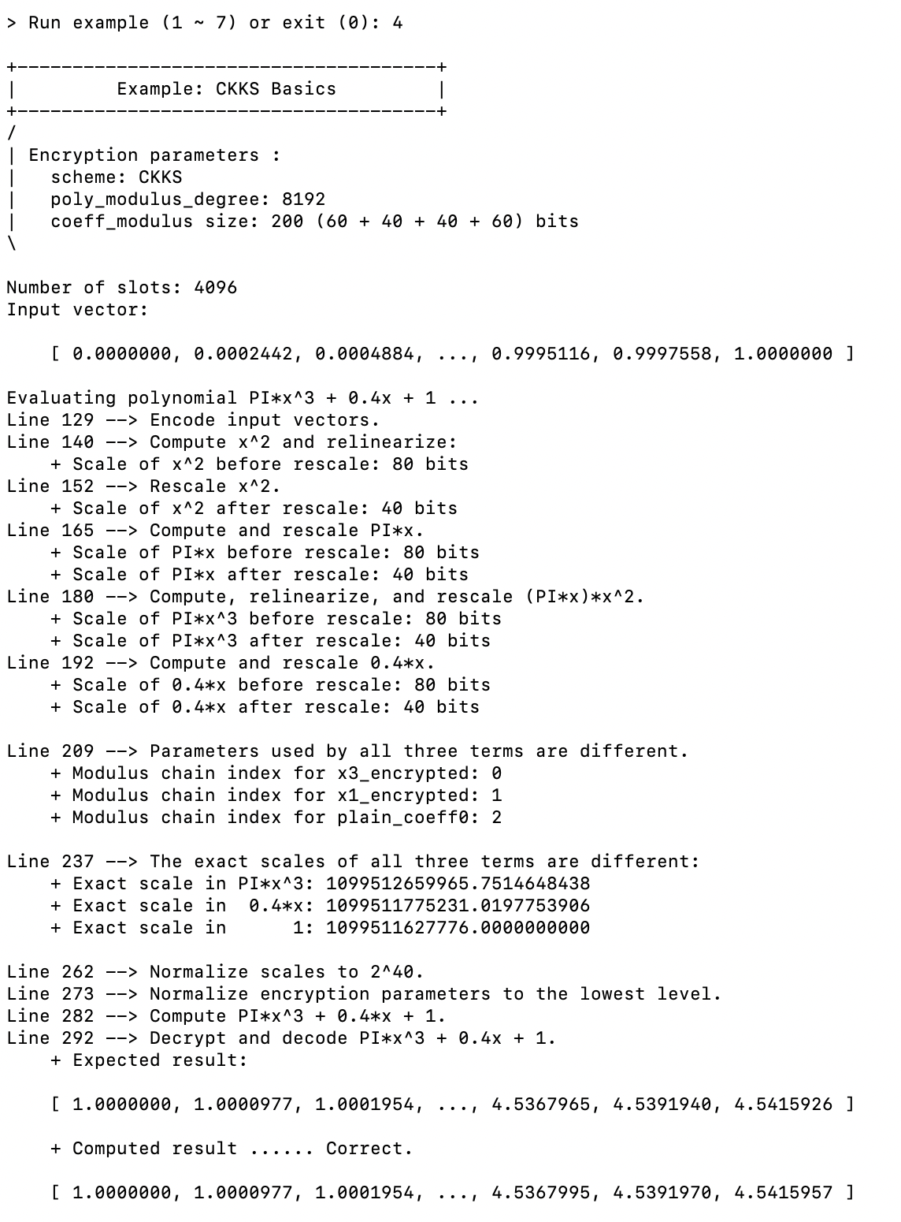

Slide 9
2. SEAL 기본 코드 작성
간단한 예시 코드 돌려보기
Notes:
23 sec

Slide 10
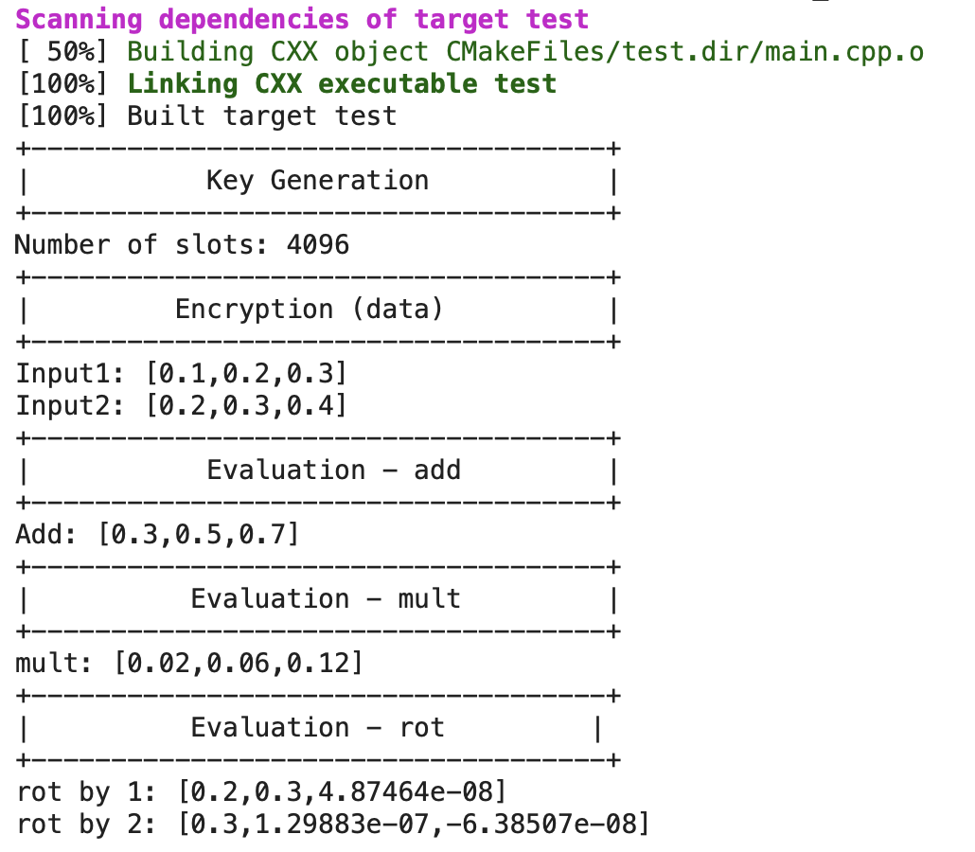

Slide 11




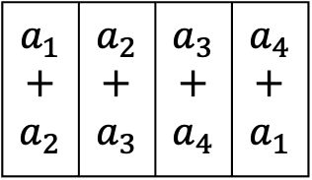





3. Rotate & Sum 연산
$$a_{1}$$ | $$a_{2}$$ | $$a_{3}$$ | $$a_{4}$$
$$a_{1}+a_{2}$$ | $$a_{2}+a_{3}$$ | $$a_{3}+a_{4}$$ | $$a_{4}+a_{1}$$
Rotate
Rotate
$$+$$
$$a_{2}$$ | $$a_{3}$$ | $$a_{4}$$ | $$a_{1}$$
$$+$$
$$a_{3}+a_{4}$$ | $$a_{4}+a_{1}$$ | $$a_{1}+a_{2}$$ | $$a_{2}+a_{3}$$
$$a_{1}+$$ $$a_{2}$$ | $$a_{2}+$$ $$a_{3}$$ | $$a_{3}+$$ $$a_{4}$$ | $$a_{4}+$$ $$a_{1}$$
$$A$$ | $$A$$ | $$A$$ | $$A$$
$$A=a_{1}+a_{2}+a_{3}+a_{4}$$

Slide 12



3. Rotate & Sum 연산
1. 벡터 암호화
$$0.1$$ | $$0.1$$ | $$0.1$$ | $$0.1$$ | $$0.1$$ | $$0.1$$ | $$0.1$$ | $$0.1$$
2. Rotate & Sum 연산 구현
$$A$$ | $$−$$ | $$−$$ | $$−$$
$$0.1+0.1+0.1+0.1+0.1+0.1+0.1+0.1≈0.8$$
3. 결과 복호화
$$0.8$$

Slide 13
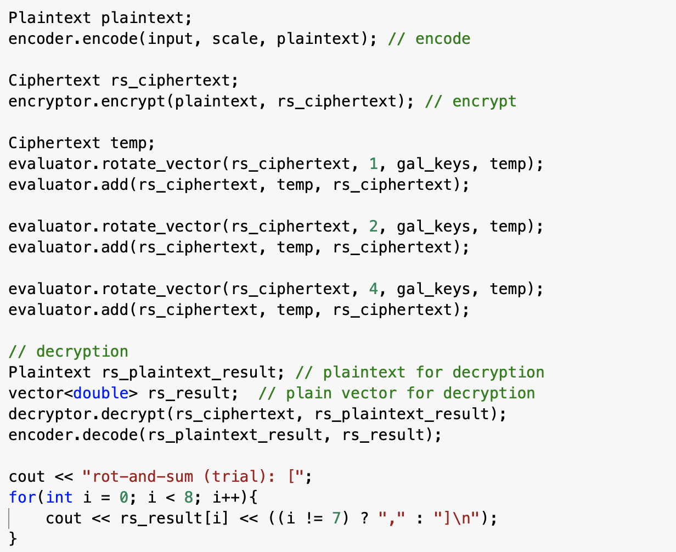

Slide 14



3. Rotate & Sum 연산
1. 벡터 암호화
$$0.1$$ | $$0.1$$ | $$0.1$$ | $$0.1$$ | $$0.1$$ | $$0.1$$ | $$0.1$$ | $$0.1$$
$$0$$ | $$0$$ | $$0$$ | $$0$$ | $$0$$ | $$0$$ | $$0$$ | $$0$$
2. Rotate & Sum 연산 구현
$$A$$ | $$B$$ | $$−$$ | $$−$$
$$0.1+0.1+0.1+0.1+0.1+0.1+0.1≈0.7$$
3. 결과 복호화
$$0.8$$ | $$0.7$$

Slide 15

3. Rotate & Sum 연산
1. 벡터 암호화
$$0.1$$ | $$0.1$$ | $$0.1$$ | $$0.1$$ | $$0.1$$ | $$0.1$$ | $$0.1$$ | $$0.1$$
$$0$$ | $$0$$ | $$0$$ | $$0$$ | $$0$$ | $$0$$ | $$0$$ | $$0$$
2. Rotate & Sum 연산 구현
$$A$$ | $$B$$ | $$−$$ | $$−$$
$$0.1+0.1+0.1+0.1+0.1+0.1+0.1≈0.7$$
3. 결과 복호화
$$0.8$$ | $$0.7$$ | $$0.6$$ | $$0.5$$ | $$0.4$$ | $$0.3$$ | $$0.2$$ | $$0.1$$

Slide 16




3. Rotate & Sum 연산
Q. 어떻게 다음 결과값을 얻을 수 있을까?
$$0.8$$ | $$0.8$$ | $$0.8$$ | $$0.8$$ | $$0.8$$ | $$0.8$$ | $$0.8$$ | $$0.8$$
A. fully-packed 벡터 암호화
$$0.1$$ | $$0.1$$ | $$0.1$$ | $$0.1$$ | $$0.1$$ | $$0.1$$ | $$0.1$$ | $$0.1$$
$$0.1$$ | $$0.1$$ | $$0.1$$ | $$0.1$$ | $$⋯$$ | $$⋯$$ | $$⋯$$ | $$0.1$$
slot_count
(참고: vec.push_back($0.1$))

Slide 17


3. Rotate & Sum 연산
1. 벡터 암호화
$$0.1$$ | $$0.1$$ | $$0.1$$ | $$0.1$$ | $$0.1$$ | $$0.1$$ | $$0.1$$ | $$0.1$$
$$0.1$$ | $$0.1$$ | $$0.1$$ | $$0.1$$ | $$0.1$$ | $$0.1$$ | $$0.1$$ | $$0.1$$
2. Rotate & Sum 연산 구현
$$A$$ | $$B$$ | $$−$$ | $$−$$
$$0.1+0.1+0.1+0.1+0.1+0.1+0.1≈0.8$$
3. 결과 복호화
$$0.8$$ | $$0.8$$ | $$0.8$$ | $$0.8$$ | $$0.8$$ | $$0.8$$ | $$0.8$$ | $$0.8$$

Slide 18
